Slide 1

Basics of

Slide 2
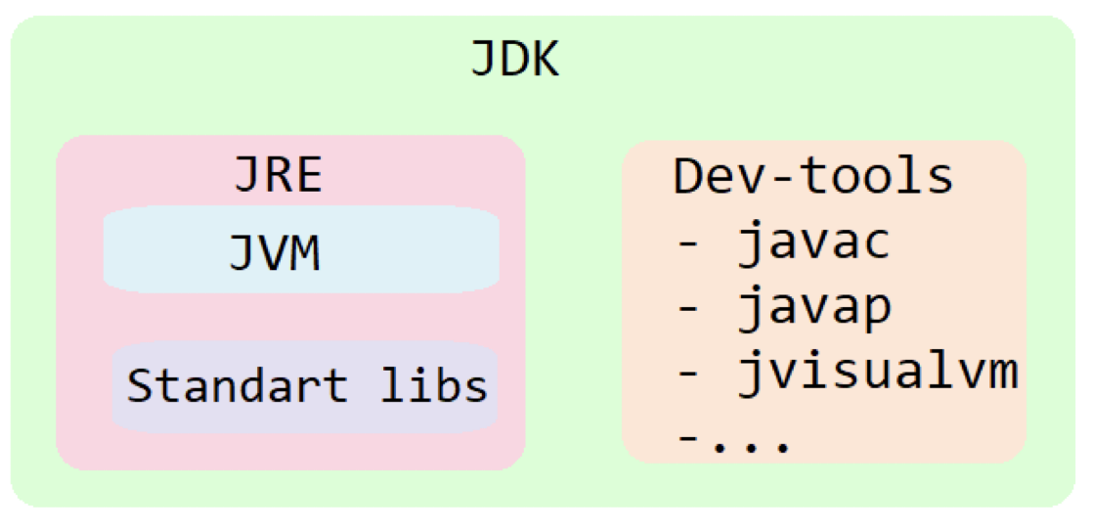
The Java Development Kit (JDK)
The Java Runtime Environment (JRE)
The Virtual Machine (JVM)

Slide 3
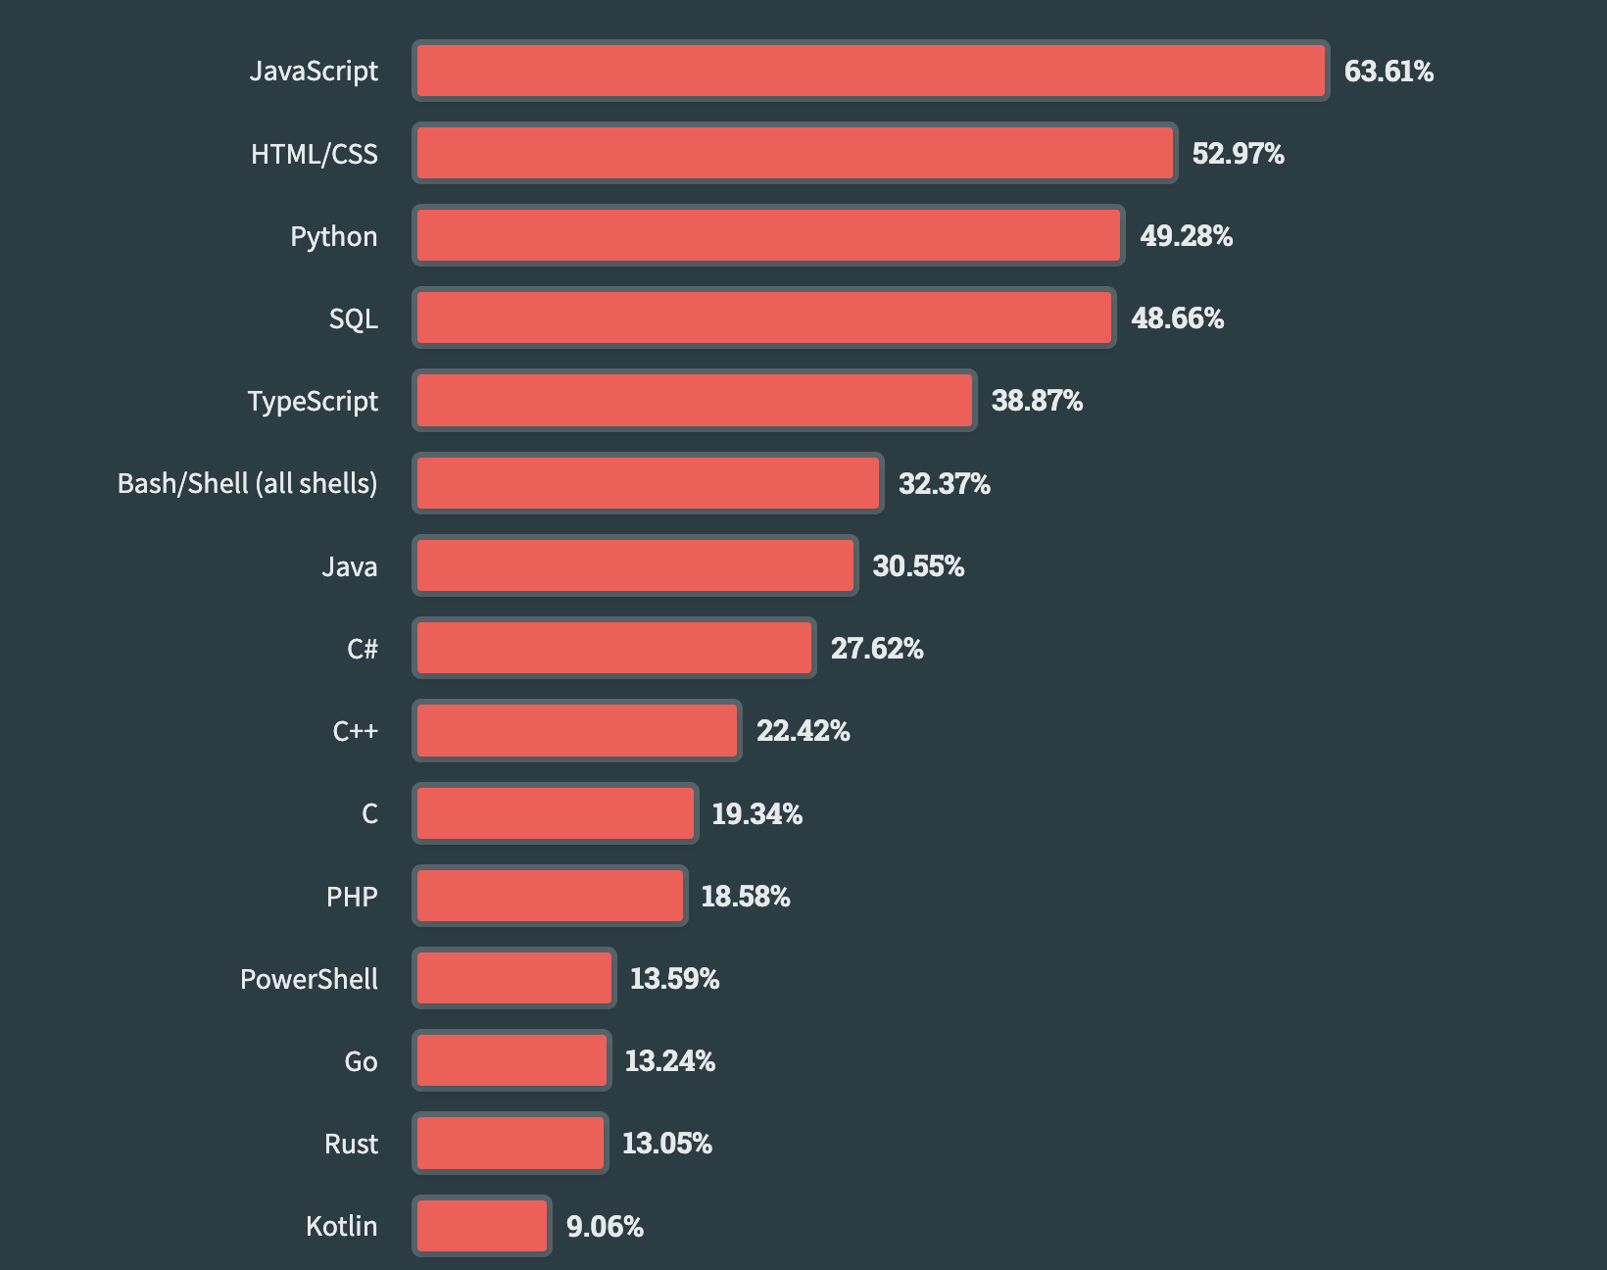

Slide 4
Syntax
Case sensitive
Each statement in Java must end with a semicolon (;)
Code blocks are enclosed in curly braces {}
Spaces (4) vs tabulation
Comments
// one line
/* multiline */
/**Java doc */

Slide 5
Variables — what are they and why do we need them?
int size = 41;

Slide 6
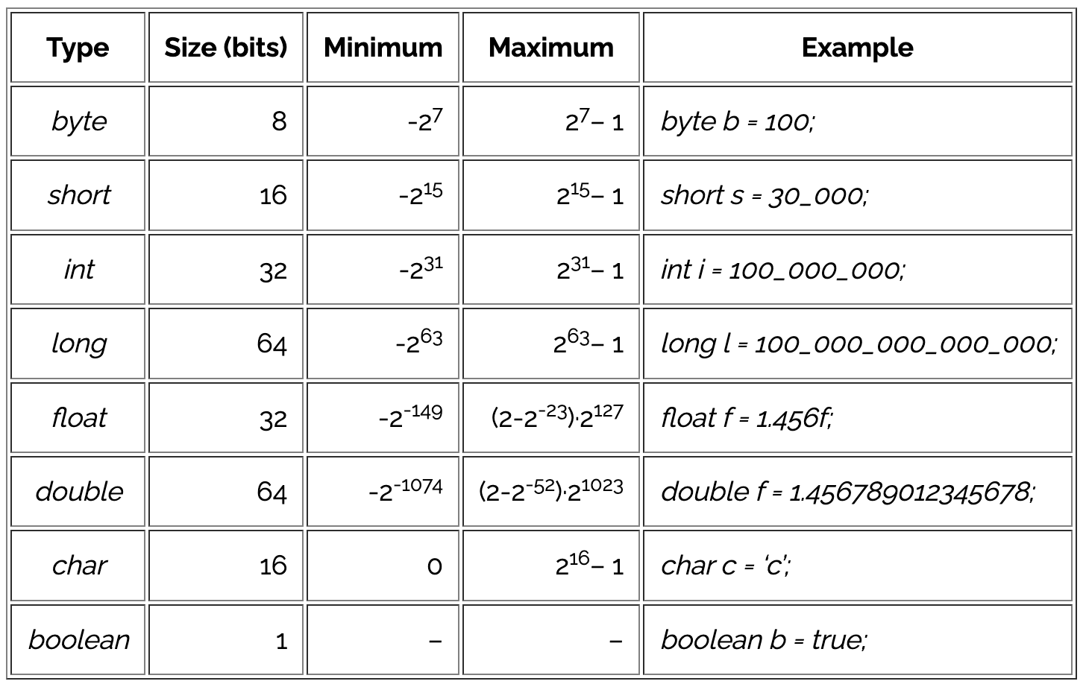
Primitives

Slide 7
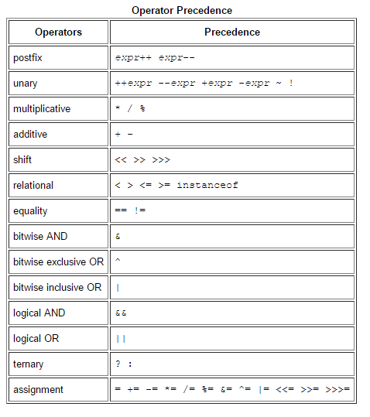
Operators

Slide 8
What will be printed?
public static void main(String[] args) {
int a = 5;
int b = a;
a = 3;
System.out.println(b);
}

Slide 9
What will be printed?
public static void main(String[] args) {
int a = 5;
increment(a);
System.out.println("a = " + a);
}
public static void increment(int a) {
a++;
}

Slide 10
If, else if, else
int n = scanner.nextInt();
if (n == 1) {
System.out.println("1");
} else if (n == 2 || n == 3) {
System.out.println("2 or 3");
} else {
System.out.println("none of above");
}

Slide 11
Ternary operator
String warning = speed > 90 ? "speeding" : "normal";

Slide 12
Switch
int k = scanner.nextInt();
switch (k) {
case 1:
System.out.println("1");
break;
case 2:
case 3:
System.out.println("2 or 3");
break;
default:
System.out.println("none of above");
}
sdf
Why do we need breaks?

Slide 13
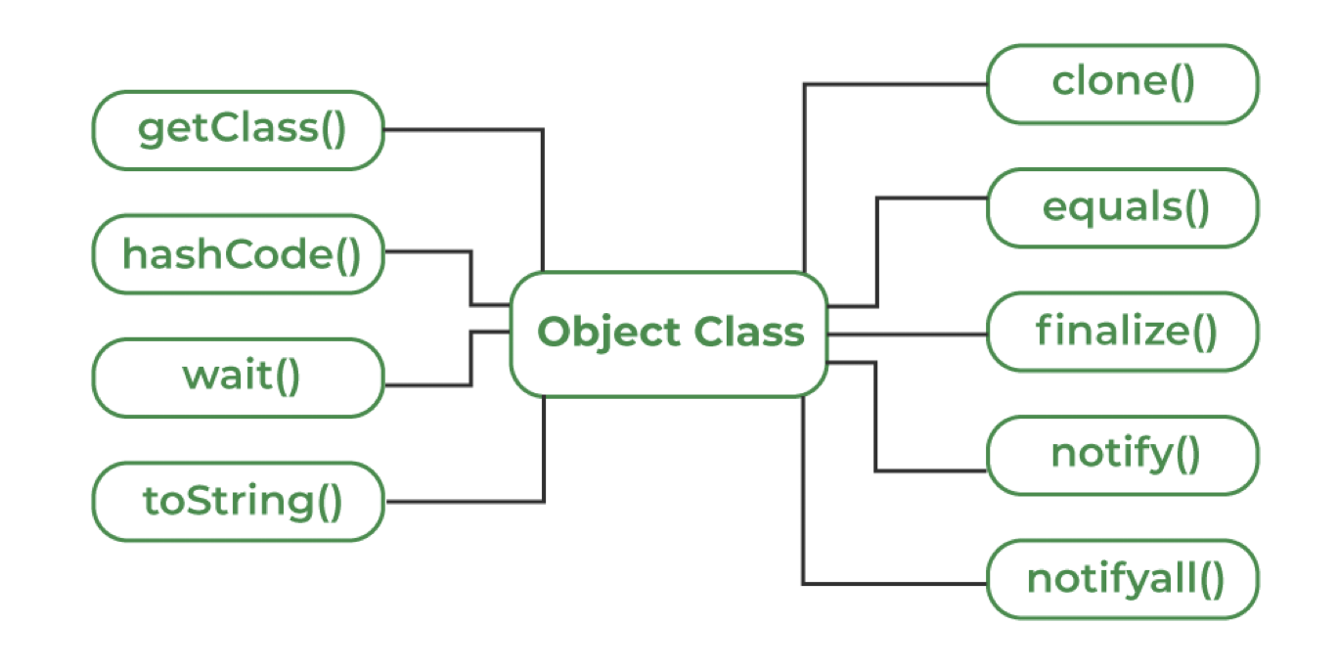
java.lang.Object
In Java, "almost" all data is object and inherit Object

Slide 14
java.lang.Object
What will be printed?
Point p1 = new Point(3, 5);
Point p2 = p1;
p1.setX(7);
System.out.println(p2.getX());
Point p3 = new Point(3, 5);
Point p4 = p3;
p3 = new Point(7, 9);
System.out.println(p4.getX());

Slide 15
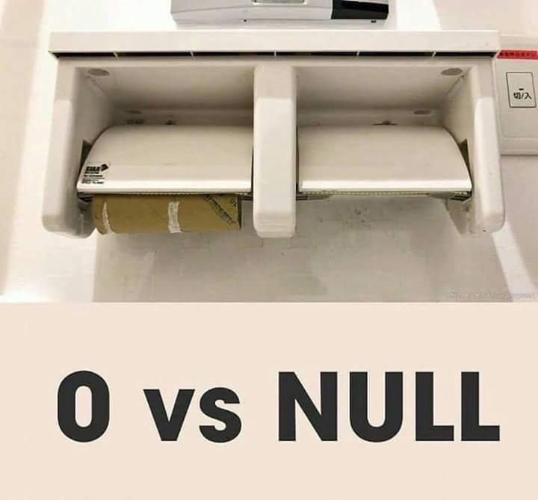
Null vs zero
String nullText = null;
String emptyText = "";
Only objects can be null
Primitive types – cannot

Slide 16
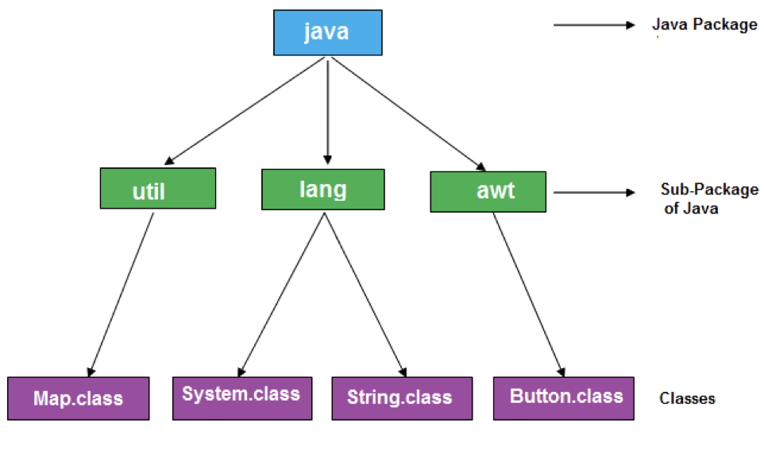
Java packages
Organization and Structuring
Name Conflicts Resolution
Access Control
…

Slide 17
Importing classes
✅
❌
import java.util.Arrays;
import java.util.Random;
import java.util.Scanner;
import java.util.*;

Slide 18
Purpose of packages
Organization and Structuring
Name Conflicts Resolution
Access Control
…

Slide 19
java.util.Arrays
Array is Object
int[] array1 = new int[5]; //[0, 0, 0, 0, 0]
for (int i = 0; i < 5; i++) { // indexing starts from 0
array1[i] = i * i; // [0, 1, 4, 9, 16]
}
Object[] array2 = new Object[3]; // [null, null, null]
String[][] twoDimensionalArray = {
{"aaa", "bbb", "cde"},
{"1", "2"}
};

Slide 20
java.util.Arrays
int[] ints = new int[5];
System.out.println("Print array as is: " + ints);
//Printing array as is: [I@3a71f4dd
System.out.println("Print array using toString: " + ints.toString());
//Printing array using toString: [I@3a71f4dd
System.out.println("Print array using Arrays.toString: " + Arrays.toString(ints));
// Printing array using Arrays.toString: [0, 0, 0, 0, 0]

Slide 21
java.util.Arrays
public static void sort(int[] a);
public static int binarySearch(int[] a, int key);
public static boolean equals(int[] a, int[] a2);
public static boolean deepEquals(Object[] a1, Object[] a2);
public static void fill(int[] a, int val);
public static String toString(int[] a);

Slide 22
“for” loop
for (initialization; condition; post action){
statement;
}
for (int count = 0; count < 5; count++){
System.out.println(count);
}

Slide 23
“for-each” loop
for (type variable : array) {
statements;
}
String[] items = {"Pen", "Pencil", "Notebook", "Copybook"};
for (String item : items) {
System.out.println(item);
}

Slide 24
“while” loop
while(condition){
statement;
}
int count = 0;
while (count < 5) {
System.out.println(count);
count++;
}

Slide 25
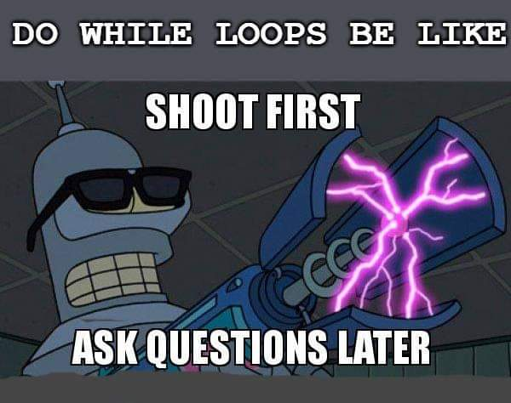
“do-while” loop
do { statement; } while (condition);
int count = 0;
do {
System.out.println(count);
count++;
} while (count < 5);

Slide 26
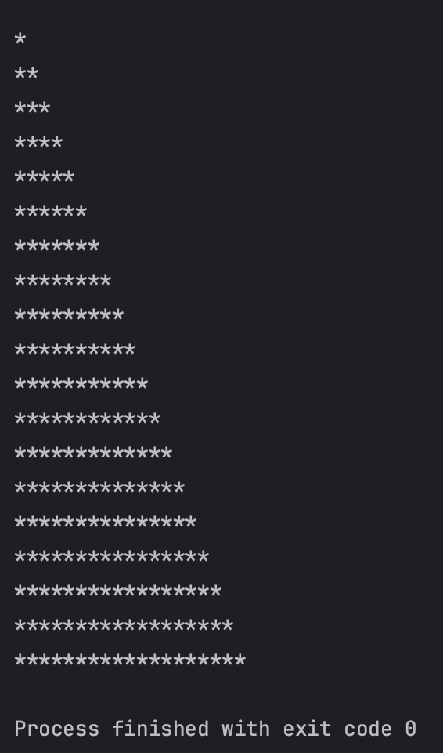
Nested loops
What will be printed?
for (int i = 0; i < 20; i++) {
for (int k = 0; k < i; k++) {
System.out.print("*");
}
System.out.println();
}

Slide 27
break vs return
Find index of the element in array
int[] numbers = {1, 2, 3, 4, 5, 6, 7, 8, 9, 10};
int target = 6;
for (int i = 0; i < numbers.length; i++) {
if (numbers[i] == target) {
System.out.println("Target number " + target + " found at index " + i);
break; // Exit the loop when the target is found
}
}

Slide 28
continue
Used to skip the current iteration of a loop and proceed to the next iteration
for (int i = 1; i <= 5; i++) {
if (i == 3) {
continue; // Skip iteration when i is 3
}
System.out.println("Current value of i is: " + i);
}

Slide 29
String — a sequence of characters
String empty = "";
String emptyUsingConstructor = new String();
String hello = new String("Hello");
String world = "World";
String greeting = hello.concat(" ").concat(world) + "!";

Slide 30
Useful methods of String class
int length();
boolean isBlank();
boolean equals(Object anObject);
int indexOf(int ch);
String repeat(int count);
String substring(int beginIndex, int endIndex);
String concat(String str);
boolean contains(CharSequence s);
String replace(char oldChar, char newChar);
String strip();
String[] split(String regex);
…

Slide 31
Immutability of String
String character = "Sponge Bob";
System.out.println(character.toLowerCase()); // sponge bob
System.out.println(character); // Sponge Bob

Slide 32
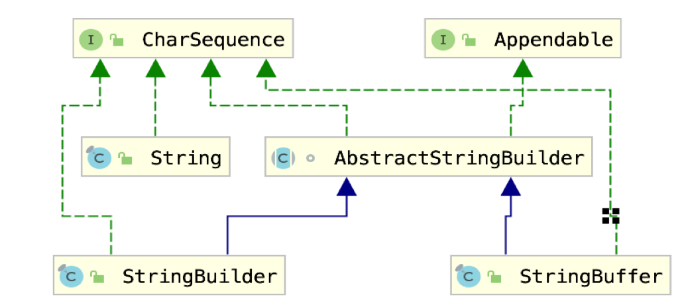

Slide 33
StringBuilder / StringBuffer
StringBuilder append(Object obj);
StringBuilder delete(int start, int end);
StringBuilder replace(int start, int end, String str);
StringBuilder insert(int index, char[] str, int offset);
int indexOf(String str);
int lastIndexOf(String str);
StringBuilder reverse();
String concat(String str);
…

Slide 34
String pool
1. true, true
String color1 = "green";
String color2 = "green";
println(color1 == color2);
println(color1.equals(color2));
String color5 = new String("red");
String color6 = new String("red");
println(color5 == color6);
println(color5.equals(color6));
2. false, true
3. false, true
String color3 = "blue";
String color4 = new String("blue");
println(color3 == color4);
println(color3.equals(color4));

Slide 35
Methods
Wrapping methods:
Integer::valueOf(int)
Integer::valueOf(String)
Double::valueOf(double)
Integer::parseInt(String)
…
Constants like min/max values of primitive types:
Integer.MAX_VALUE
…
Conversion to another type:
Number::intValue
Number::floatValue
…

Slide 36
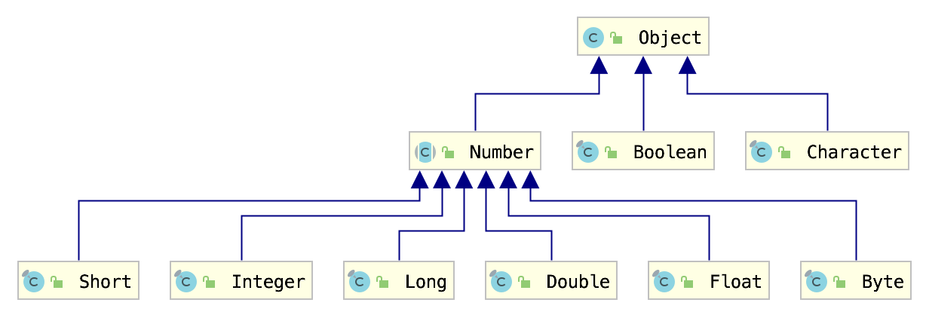
Wrapper classes

Slide 37
Autoboxing and Unboxing
Integer autoboxed = 47; // -> Integer.valueOf(47);
int unboxed = Integer.valueOf(47); // -> intValue()

Slide 38
java.lang.Math
public static double sin(double a)
public static double cos(double a)
public static double exp(double a)
public static double sqrt(double a)
public static double pow(double a, double b)
public static int round(float a)
public static int abs(int a)
public static int max(int a, int b)
public static int min(int a, int b)
Math.PI
Math.E
…

Slide 39
java.lang.System
System.out.printf("Hello %s!%n", "World");
System.out.println("Hello World!");
System.currentTimeMillis();
System.exit(1);
System.getProperty("path.separator");
System.gc();

Slide 40
java.util.Scanner
Scanner scanner = new Scanner(System.in);
String item = scanner.next();
double price = scanner.nextDouble();
scanner.close(); // !!!

Slide 41
Methods: example
method declaration consists of modifiers (public, static, …)
return type or void in the method does not return anything
list of input params (type + name) separated with commas
body of the method
Return statement: optional for the void methods, required otherwise
Note: add static modifier to the method if you need to call it from the main method
public static void main(String[] args) {
printGradeRepresentation(5);
}
public static void printGradeRepresentation(int grade) {
String gradeRepresentation = getGradeRepresentation(grade);
System.out.println(gradeRepresentation);
}
public static String getGradeRepresentation(int grade) {
if (grade == 5) {
return "Awesome";
} else if (grade == 4) {
return "Good";
} else if (grade == 3) {
return "Acceptable";
} else if (grade > 0 && grade < 3) {
return "Bad";
} else {
return "Unknown";
}
}

Slide 42
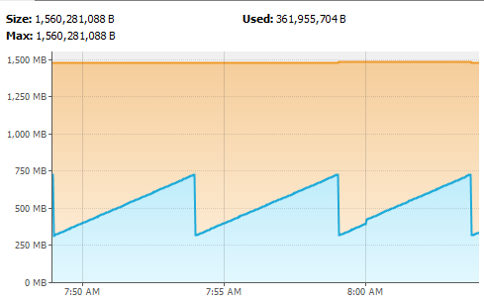
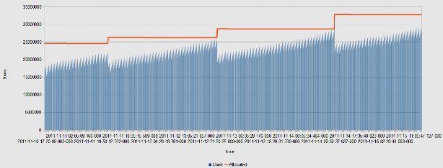
Garbage collector
Healthy
Unhealthy

Slide 43
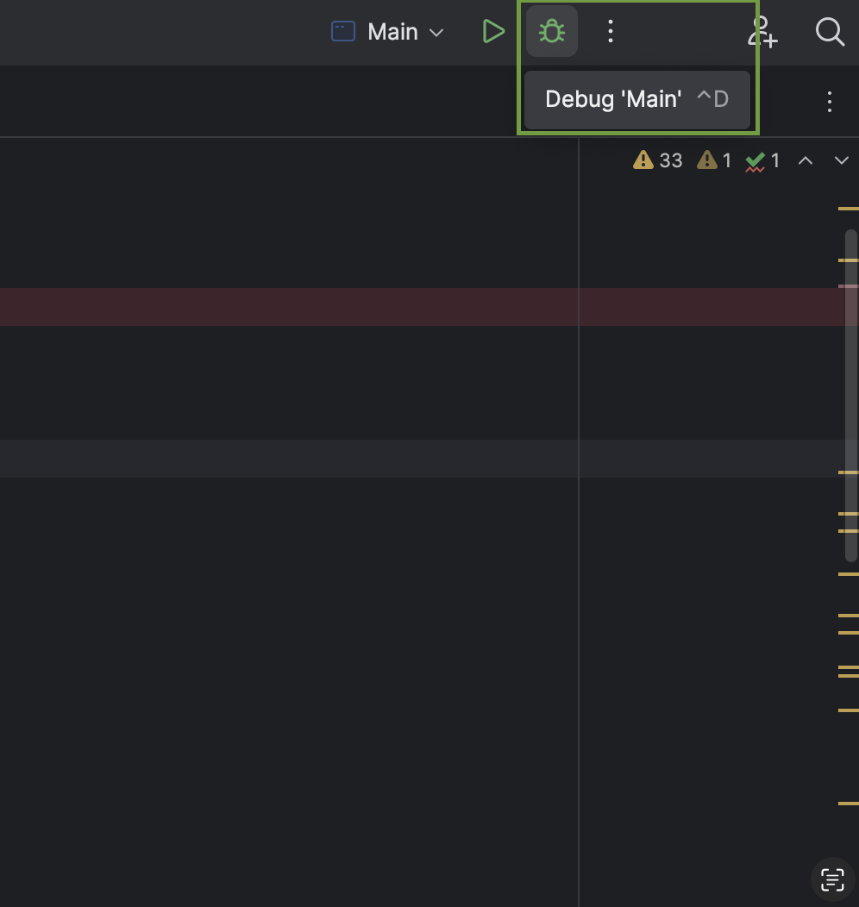
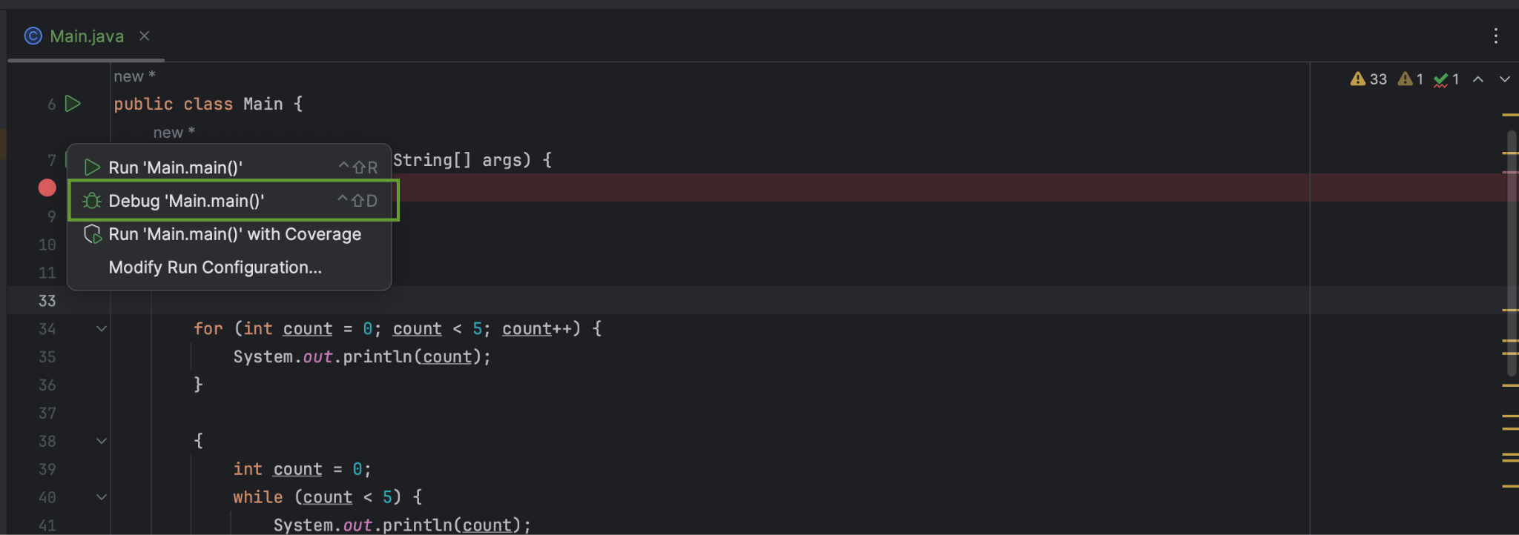
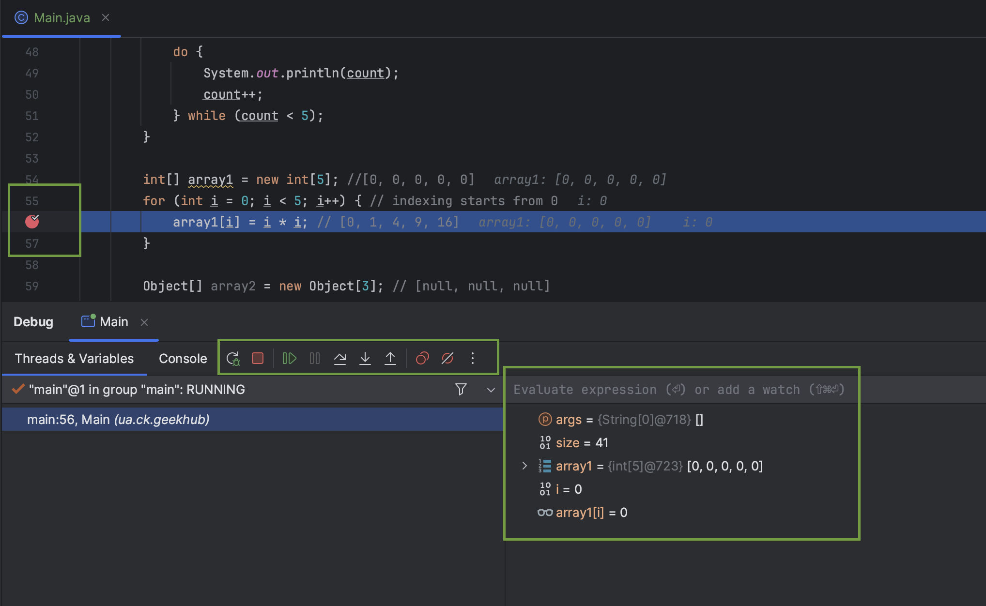
Debugging

Slide 44
Literature
Java basics:
Baeldung: Get Started with Java
https://www.baeldung.com/get-started-with-java-series
Baeldung: Methods in Java
https://www.baeldung.com/java-methods
Books:
“Clean Code” by Robert Martin (chapter 1-2)
“Java: The Complete Reference” by Herbert Schildt (chapter 2-5)

Slide 45
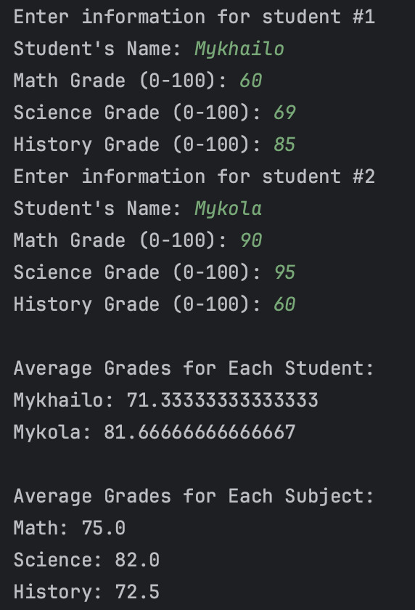
Homework
Implement the program, that will collect the information about students and print analytics
The total number of students must be provided via program arguments
If the number of students is not provided — print some error message to console and exit
For each student, the program should prompt the user to input their name and three grades (math, science, and history).
If student name is empty — ask to write it again
Allowed values for degrees — 0-100 inclusively, if the inputted value is out of this range, ask to input it again
Display the average grade for each student.
Display the average grade for each subject.
Commit your messages, create issue in the GitHub, assign it to all mentors
Write your code in the 02-Basics module (fetch changes from the template repository)
Do not:
create own classes
use not covered in the preceding lectures things
Do:
create own methods
format your code
…

Slide 46
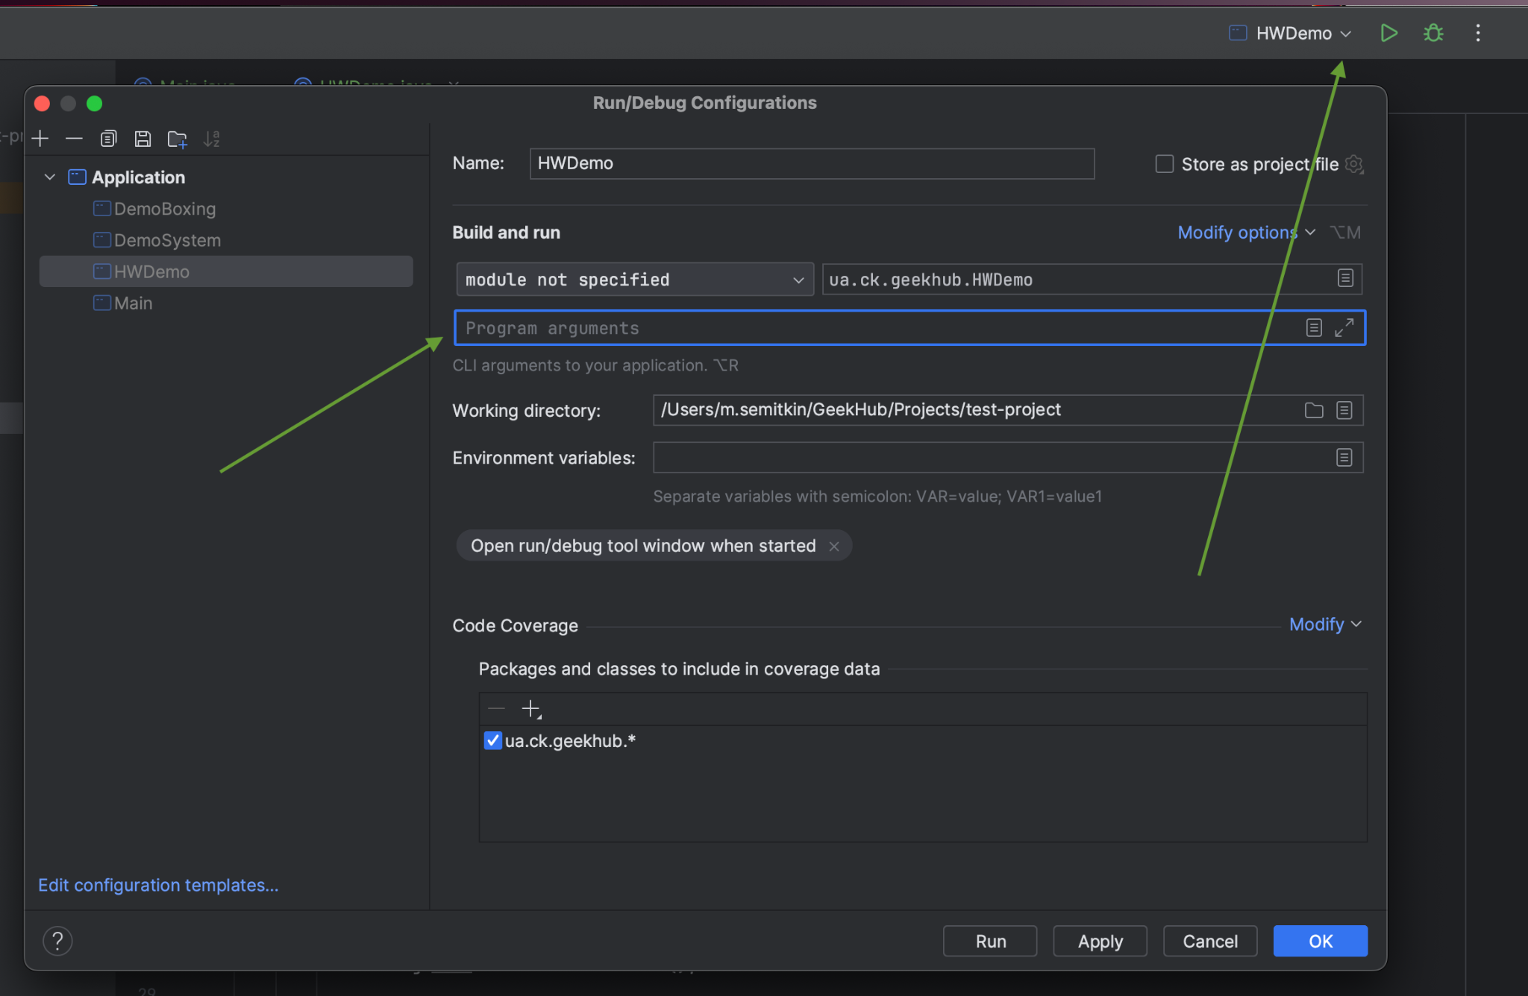
Hint

Slide 47

Good luck :)

